Slide 1
Validating tools to improve efficiency of assessing miners for tuberculosis (TB) and silicosis . Objectives, results-to date, and plans
Annalee Yassi, Jerry Spiegel, Steven Barker and colleagues from
School of Population and Public Health, University of British Columbia (UBC)*,
and Rodney Ehrlich, University of Cape Town (UCT)
in collaboration with U Wits, MBOD/CCOD and extended team
Funding: Canadian Institutes of Health Research and UK Department for International Development
*WHO Collaborating Centre

Slide 2
Declaration of No Conflict of Interest & Ethics review statement
No members of the research team have any commercial interest in any of the intellectual property or products being developed or studied in this project
The research conducted has been approved by UBC and UCT research ethics boards

Slide 3
Objective of this presentation
Explain what our research team has done to date to assess the use of Computer Assisted Detection (CAD) for TB and silicosis
in a manner in which everyone here can help determine the next step

Slide 4
Terminology, Complexities and Methods

Slide 5
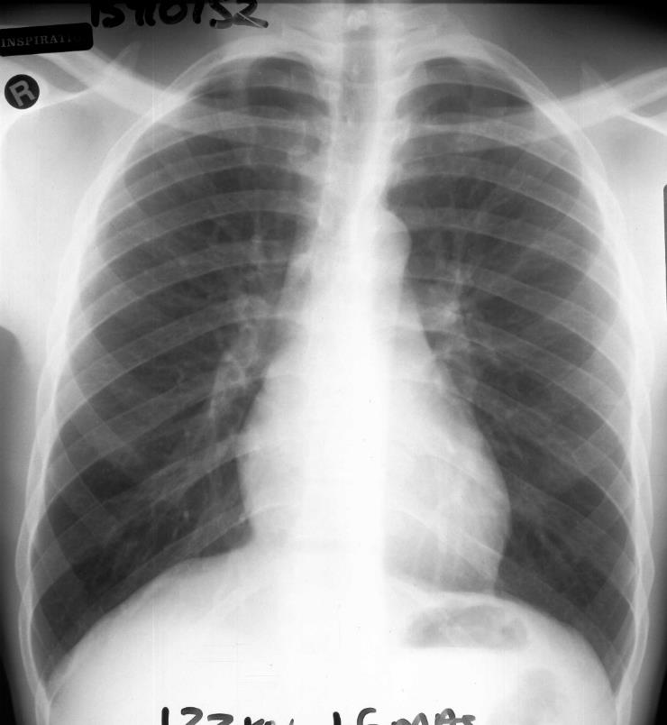
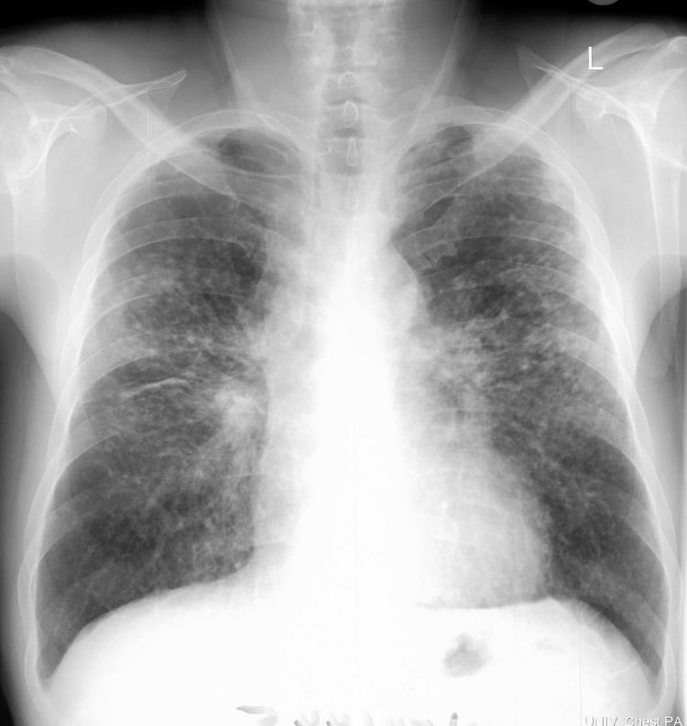
Normal
Silicosis
Silica dust exposures: various health effects including
silicosis (a chronic non-infectious disease), and
increases lifetime risk for tuberculosis (an infectious disease of considerable public health concern)

Slide 6
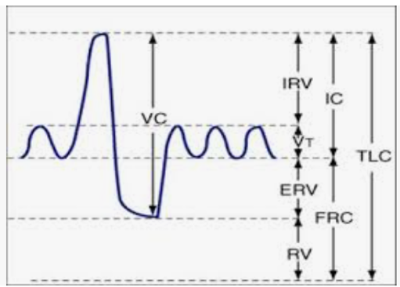
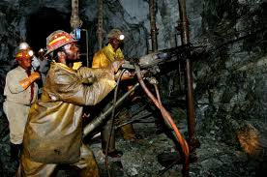
Processing compensation claims
Exposure history
Clinical assessment
Years of exposure
Years of service
Years since first service
Age
Occupation (risk for silica dust exposure)
Questionnaire to screen for symptoms - to trigger testing for active TB
Lung function tests -- to determine impairment
Chest X-ray
Plus previous history/assessments

Slide 7
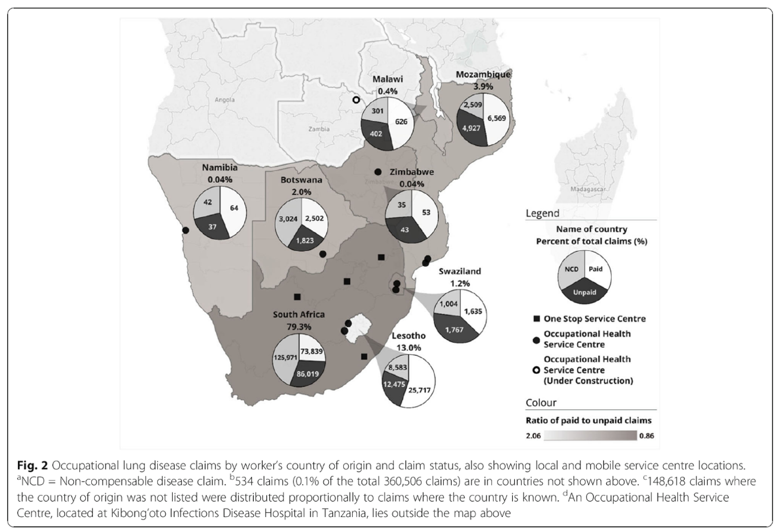
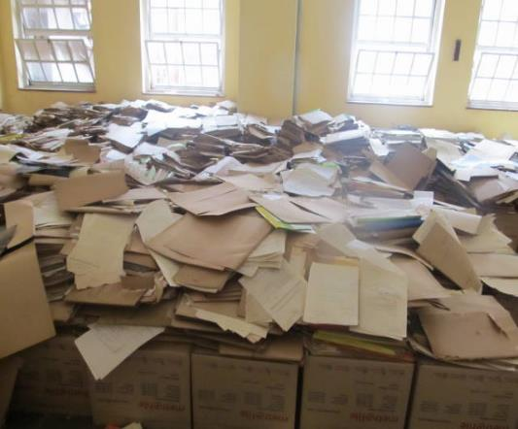
Huge amount of work has gone into creating an MBOD/CCOD database and reaching out across southern Africa

Slide 8
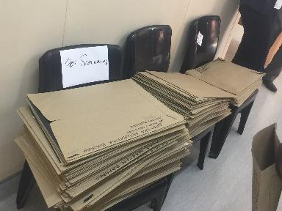
Overall premise: “Justice Delayed is Justice Denied”
Objective: Improve efficacious provision of compensation
Main focus of our research: two of the rate-limiting steps:
getting the right people through the doors:
b) decreasing the time from assessment (BME) until Certification
Can Artificial Intelligence (AI) / Computer-Assisted Detection (CAD) speed up the process without losing accuracy (or fairness)?

Slide 9
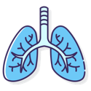
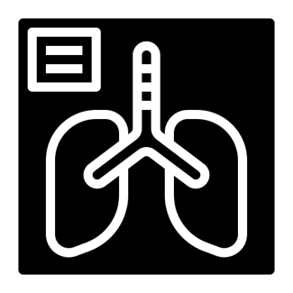
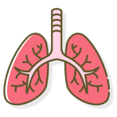
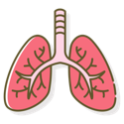
100%
CAD
?
0%

Slide 10
Terminology and Complexities
 | GOLD STANDARD- (i.e. reality as best we know it) Certification Panel designation Expert external readers (1, 2, both?) Designation positive | GOLD STANDARD Designation negative
CAD designation positive | True positive | False positive
CAD designation positive | False negative | True negative

Slide 11
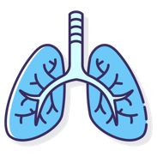
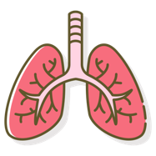
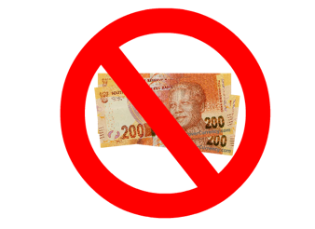
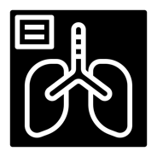
WHAT’S REAL
 | Diseased lungs | Non-diseased lungs
CAD Positive | True positive | False positive
CAD Negative | False negative | True negative
WHAT CAD SHOWS

Slide 12
Good sensitivity
=
Few
false negatives

Slide 13
Good specificity
=
Few
false positives

Slide 14
sensitivity
specificity

Slide 15
Terms in assessing CAD
Sensitivity = as few false negatives as possible: No
Specificity = as few false positives as possible: No
Accuracy = as few false results as possible (balancing the above)

Slide 16
100%
CAD Score
Negative -
Positive +
Threshold
0%

Slide 17
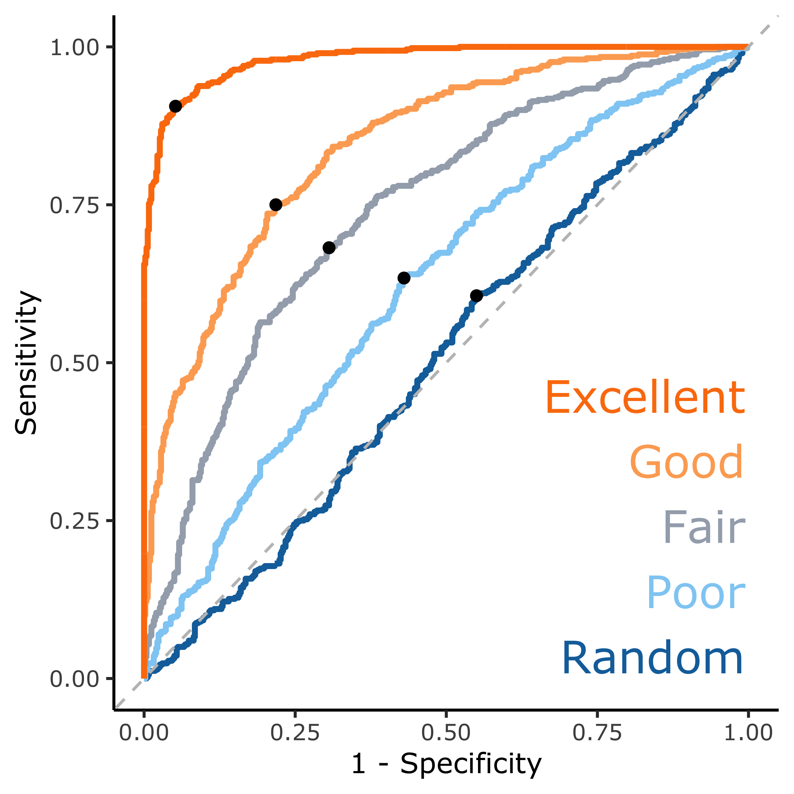
Area Under the Curve (AUC) AUC quantifies how the CAD system performed. Goal: as near to top left corner as possible

Slide 18
These curves are made by considering every possible threshold and plotting the sensitivity against the specificity. The “•” on the curve shows a potential balanced threshold where sensitivity and specificity are both highest.

Slide 19
Triage
Use a 2-person panel for CXRs deemed by CAD to be normal or pure TB only – with “false negatives or uncertain” (when 2-person panel disagrees with CAD) referred to full panel, and
use “the radiologist + 4-person panel” for all others from the start

Slide 20
Accuracy will determine Efficiency
– i.e. If instead of 40% of the cases coming to the “radiologist+ 4-person Certification Panel” being compensable (true positives), it could be 80%: system will be more efficient.
BUT, if there are many false negatives (files that are assessed by 2-person THEN REFERRED to + 4-person) there would be a loss of efficiency -- hence need to reduce false negatives.
BUT, if there are very many false positives that go to the 4-person panels – that would also decrease efficiency
So accuracy and efficiency are needed for social justice!

Slide 21
What we did so far in validating CAD for this purpose
1.Pre- Trial #1: 152 CXRs
- data presented in April 2019;
- identified technical issues that had to be addressed in further trials
2. Trial #1 – 330 CXRs (retrospective gold standard assessment)
- described in next few slides (4 vendors)
3. Pre-Trial #2 – 286 CXRs
-assessed images that were originally digital, then printed, mailed to MBOD then scanned to DICOM format. (2 vendors) – results were poor (AUC ~0.5-0.6 for TB)
3. Trial #2 – 501 CXRs (prospective ‘field’ gold standard assessment)
- described below (3 vendors)
4. Trial #3 – 867 CXRs (retrospective gold standard assessment) (1 vendor)
Notes:
There was a trial of “287” images between trials 1 and 2, around the start of 2020. This trial actually had 256 images that were originally digital, but were then printed, mailed to MBOD then re-scanned into DICOM format. Only vendors B and C from Trial #1 participated, and only submitted TB scores which would be used for triage. The image quality was extremely poor, and the CAD output was very poor as a result, with vendors failing to replicate their Trial #1 results, which used native digital images. This CAD result set was not heavily analyzed, with AUCs around 0.5-0.6 for TB.

Slide 22
RESULTS
(Trials 1, 2, 3)

Slide 23
Peer-reviewed publications to date:
Kistnasamy B, Yassi A, Yu J, Spiegel SJ, Fourie A, Barker S, Spiegel JM. Tackling injustices of occupational lung disease acquired in South African mines: Recent developments and ongoing challenges. Globalization and Health. 2018 Dec;14(1):1-4.
Young C, Barker S, Ehrlich R, Kistnasamy B, Yassi A. Computer-aided detection for tuberculosis and silicosis in chest radiographs of gold miners of South Africa. Intern’l J TB & Lung Disease. 2020 Apr 1;24(4):444-51.
Ehrlich R, Barker S, te Water Naude J, Rees D, Kistnasamy B, Naidoo J, Yassi A. Accuracy of Computer-Aided Detection of Occupational Lung Disease: Silicosis and Pulmonary Tuberculosis in Ex-Miners from the SA Gold Mines. International J Environ Research and Public Health. 2022 Sep 29;19(19):12402.
Barker S, Ehrlich R, Spiegel JM, Kistnasamy B, Riera F, Fourie A, Mtshali N, Rabada M, Lockhart K, Yassi A. Reforming the workers’ compensation process for occupational lung disease among miners in South Africa: An efficiency study of claims assessment. International Archives of Occ and Environl Health. 2022;95(4):825-33.
Williams H, Ehrlich R, Barker S, Kisting-Cairncross S, Zungu M, Yassi A. Utility of length of mining Service and latency in predicting silicosis …. Intern’l j environ research and public health. 2022 Mar 17;19(6):3562.
Ehrlich R, Barker S, Tsang VW, Kistnasamy B, Yassi A. Access of migrant gold miners to compensation for occupational lung disease: Quantifying a legacy of injustice. J Migration & Health. 2021 Jan 1;4:100065.
Spiegel JM, Ehrlich R, Yassi A, Riera F, Wilkinson J, Lockhart K, Barker S, Kistnasamy B. Using artificial intelligence for high-volume identification of silicosis and tuberculosis: A bio-ethics approach. Annals of Global Health. 2021;87(1).

Slide 24
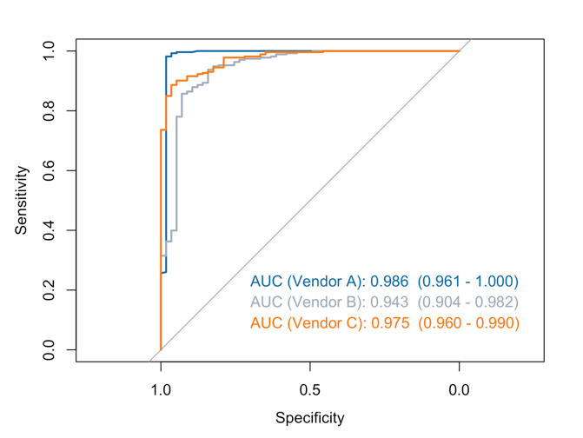
Results from Trial #1 - the 330 CAD-CXR: Young, C., Barker, S., Ehrlich, R., Kistnasamy, B., & Yassi, A. (2020). Computer-aided detection for tuberculosis and silicosis in chest radiographs of gold miners of South Africa. The International Journal of Tuberculosis and Lung Disease, 24(4), 444-451.
Detecting any abnormality (silicosis, TB, or silicotuberculosis)
compared to normal:
Able to achieve sensitivity of 98.2% and a specificity of 98.2%

Slide 25
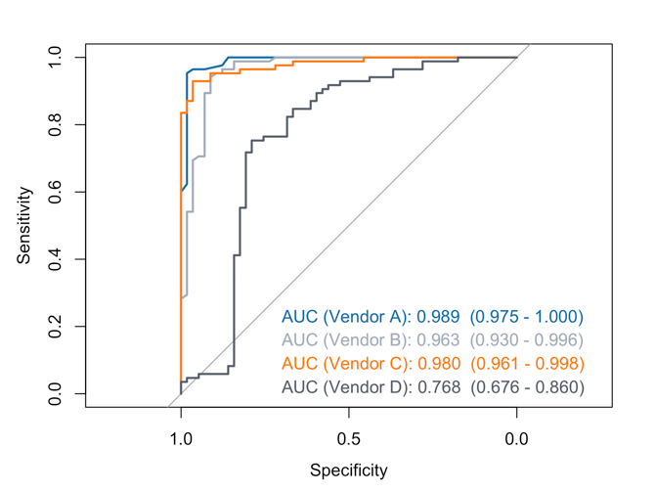
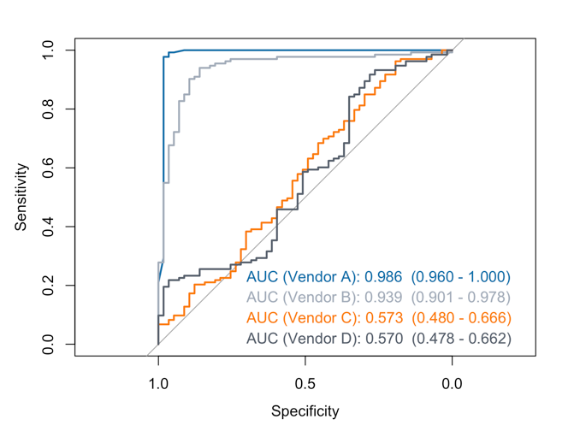
Differentiating TB from normal CXRs - also significantly greater than chance (3 companies).
Differentiating silicosis from normal – 2 of the companies also significantly greater than chance (but not quite as good as for TB)

Slide 26
Next steps on this – (RODNEY or STEVE need to make this accurate
TB versus Normal Trial 1: Vendor A (N=142) Sensitivity: 96% Specificity: 96% Balanced accuracy: 96% | Lungs with TB N=85 | Normal lungs N=57
CAD Positive N=84 | True positive 82 | False positive 2
CAD Negative N=58 | False negative 3 | True negative 55
287 CXRs – including ~100 ex-miners plus current miners who presented to the clinic at Harmony Gold May-June 2019
Assessed by 2 (or in some cases 3) AI companies
Those in which at all vendors agreed were normal or TB only sent to 2-person panel; others sent to radiologist + 4-person Panel
Results: ……
Notes:
Simple TB (no silicoTB) versus normal lungs

Slide 27
Next steps on this – (RODNEY or STEVE need to make this accurate
TB versus Normal Trial 1: Vendor B (N=142) Sensitivity: 94% Specificity: 91% Balanced accuracy: 93% | Lungs with TB N=85 | Normal lungs N=57
CAD Positive N=85 | True positive 80 | False positive 5
CAD Negative N=57 | False negative 5 | True negative 52
287 CXRs – including ~100 ex-miners plus current miners who presented to the clinic at Harmony Gold May-June 2019
Assessed by 2 (or in some cases 3) AI companies
Those in which at all vendors agreed were normal or TB only sent to 2-person panel; others sent to radiologist + 4-person Panel
Results: ……
Notes:
Simple TB (no silicoTB) versus normal lungs

Slide 28
Next steps on this – (RODNEY or STEVE need to make this accurate
Silicosis versus Normal Trial 1: Vendor A (N=190) Sensitivity: 98% Specificity: 98% Balanced accuracy: 98% | Lungs with Silicosis N=133 | Normal lungs N=57
CAD Positive N=131 | True positive 130 | False positive 1
CAD Negative N=59 | False negative 3 | True negative 56
287 CXRs – including ~100 ex-miners plus current miners who presented to the clinic at Harmony Gold May-June 2019
Assessed by 2 (or in some cases 3) AI companies
Those in which at all vendors agreed were normal or TB only sent to 2-person panel; others sent to radiologist + 4-person Panel
Results: ……
Notes:
Simple silicosis (no silicoTB) versus normal lungs.

Slide 29
Next steps on this – (RODNEY or STEVE need to make this accurate
Silicosis versus Normal Trial 1: Vendor B (N=190) Sensitivity: 90% Specificity: 89% Balanced accuracy: 90% | Lungs with Silicosis N=133 | Normal lungs N=57
CAD Positive N=126 | True positive 120 | False positive 6
CAD Negative N=64 | False negative 13 | True negative 51
287 CXRs – including ~100 ex-miners plus current miners who presented to the clinic at Harmony Gold May-June 2019
Assessed by 2 (or in some cases 3) AI companies
Those in which at all vendors agreed were normal or TB only sent to 2-person panel; others sent to radiologist + 4-person Panel
Results: ……
Notes:
Simple silicosis (no silicoTB) versus normal lungs.

Slide 30
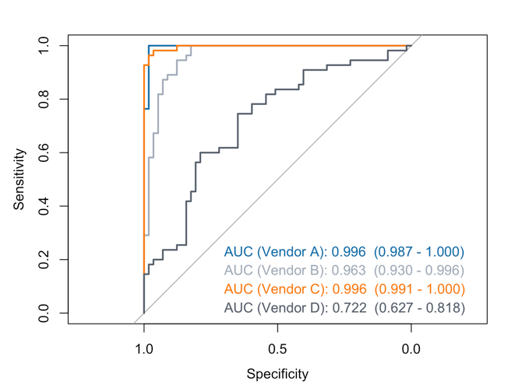
Differentiate silicotuberculosis from normal CXRs – also good

Slide 31
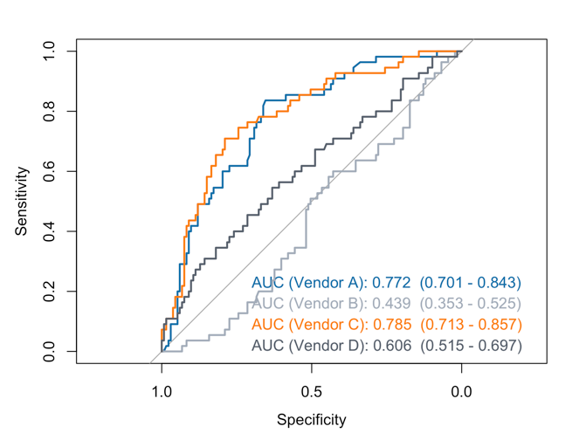
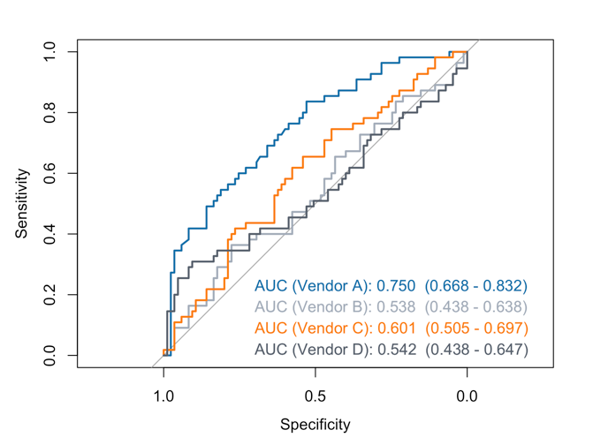
BUT
No system could differentiate between silicotuberculosis and silicosis
Or between silico TB and TB .
……no system could achieve an AUC above 0.9 for either of these

Slide 32
Next steps on this – (RODNEY or STEVE need to make this accurate
TB versus Not TB Trial 1: Vendor A (N=330) Sensitivity: 75% Specificity: 68% Balanced accuracy: 72% | Lungs with TB N=140 | Lungs without TB N=190
CAD Positive N=165 | True positive 105 | False positive 60
CAD Negative N=165 | False negative 35 | True negative 130
287 CXRs – including ~100 ex-miners plus current miners who presented to the clinic at Harmony Gold May-June 2019
Assessed by 2 (or in some cases 3) AI companies
Those in which at all vendors agreed were normal or TB only sent to 2-person panel; others sent to radiologist + 4-person Panel
Results: ……
Notes:
This is probably a better direct comparison with trial 2, but it wasn’t something we focused on in the paper for Trial 1.
Worried this may be confusing, so I’ve hidden it here.
This slide is any TB (TB or silicoTB) versus everything else (normal, silicosis) for vendor A.
AUC = 0.811

Slide 33
Next steps on this – (RODNEY or STEVE need to make this accurate
Sil. versus Not Sil. Trial 1: Vendor A (N=330) Sensitivity: 83% Specificity: 83% Balanced accuracy: 83% | Lungs with Silicosis N=188 | Lungs without Silicosis N=142
CAD Positive N=180 | True positive 156 | False positive 24
CAD Negative N=150 | False negative 32 | True negative 118
287 CXRs – including ~100 ex-miners plus current miners who presented to the clinic at Harmony Gold May-June 2019
Assessed by 2 (or in some cases 3) AI companies
Those in which at all vendors agreed were normal or TB only sent to 2-person panel; others sent to radiologist + 4-person Panel
Results: ……
Notes:
This is probably a better direct comparison with trial 2, but it wasn’t something we focused on in the paper for Trial 1.
Any Silicosis (silicosis or silicoTB) versus everything else (normal, TB).
AUC = 0.903

Slide 34
While the thresholds presented maximized the balancing of sensitivity and specificity (the Youden’s score), we could adjust the analysis to favour sensitivity at the expense of specificity or vice versa
Method | Threshold | Sensitivity | Specificity
Maximum sensitivity | 51 | 100.0% | 86.0%
Youden J Statistic | 61.5 | 95.3% | 98.2%
Maximum specificity | 80.5 | 60.0% | 100.0%

Slide 35
Target disease(s) to be detected | Pool of CXRs from which target disease(s) are detected | n (Target disease(s), All others) | Sensitivity, Specificity Provider A | Sensitivity, Specificity Provider B | Sensitivity, Specificity Provider C
Any abnormal: TB, silicosis, or silicoTB | All CXRs | 330 (273, 57) | 98.2%, 98.2% | 85.7%, 93.0% | 98.2%, 98.2%
Only TB | TB only and normal | 142 (85, 57) | 95.3%, 98.2% | 94.1%, 91.2% | 95.3%, 98.2%
Only silicosis | Silicosis only and normal | 190 (133, 57) | 97.7%, 98.2% | 94.0%, 86.0% | 97.7%, 98.2%
Only silicoTB | SilicoTB and normal | 112 (55, 57) | 100%, 98.2% | 100%, 82.5% | 100%, 98.2%
Any TB: TB or silicoTB | All CXRs | 330 (140, 190) | 87.9%, 56.3% | 94.3%, 42.1% | 87.9%, 56.3%
Any silicosis: silicosis or silicoTB | All CXRs | 330 (188, 142) | 91.0%, 76.8% | 94.1%, 43.0% | 91.0%, 76.8%

Slide 36
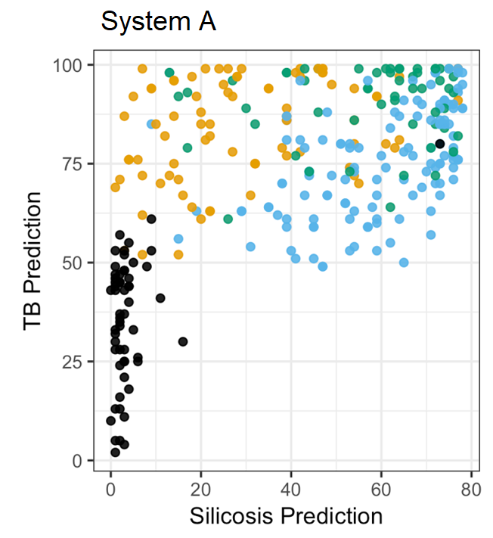

Slide 37
Trial #2 – Field trial - (CXRs not pre-selected) Ehrlich R, Barker S, te Water Naude J, Rees D, Kistnasamy B, Naidoo J, Yassi A. Accuracy of Computer-Aided Detection of Occupational Lung Disease: Silicosis and Pulmonary Tuberculosis in Ex-Miners from the SA Gold Mines. International J Environ Research and Public Health. 2022 Sep 29;19(19):12402.
501 chest X-rays (CXRs) from a screening programme (real setting)
2 commercial CAD systems for detection of “any abnormality”, TB (any) and silicosis.
tested against the readings of two expert occupational medicine specialists with experience
Results:
One system was able to detect silicosis and/or TB with high AUCs (>0.85) against both readers, and specificity better than 70% in most of the comparisons.
The other system was able to detect “any abnormality” and TB with high AUCs, but with specificity less than 70%.
Notes:
Differences with Trial 1:
CXRs were not pre-selected. This was closer to a random sample of former mine workers at Stilfontein, Alice and Bizani.
Systems needed to differentiate between TB and silicosis, which the systems failed to do very well in trial #1. That is, in detecting TB, the comparison group had silicosis cases included. In detecting silicosis, the comparison group had TB cases included.

Slide 38
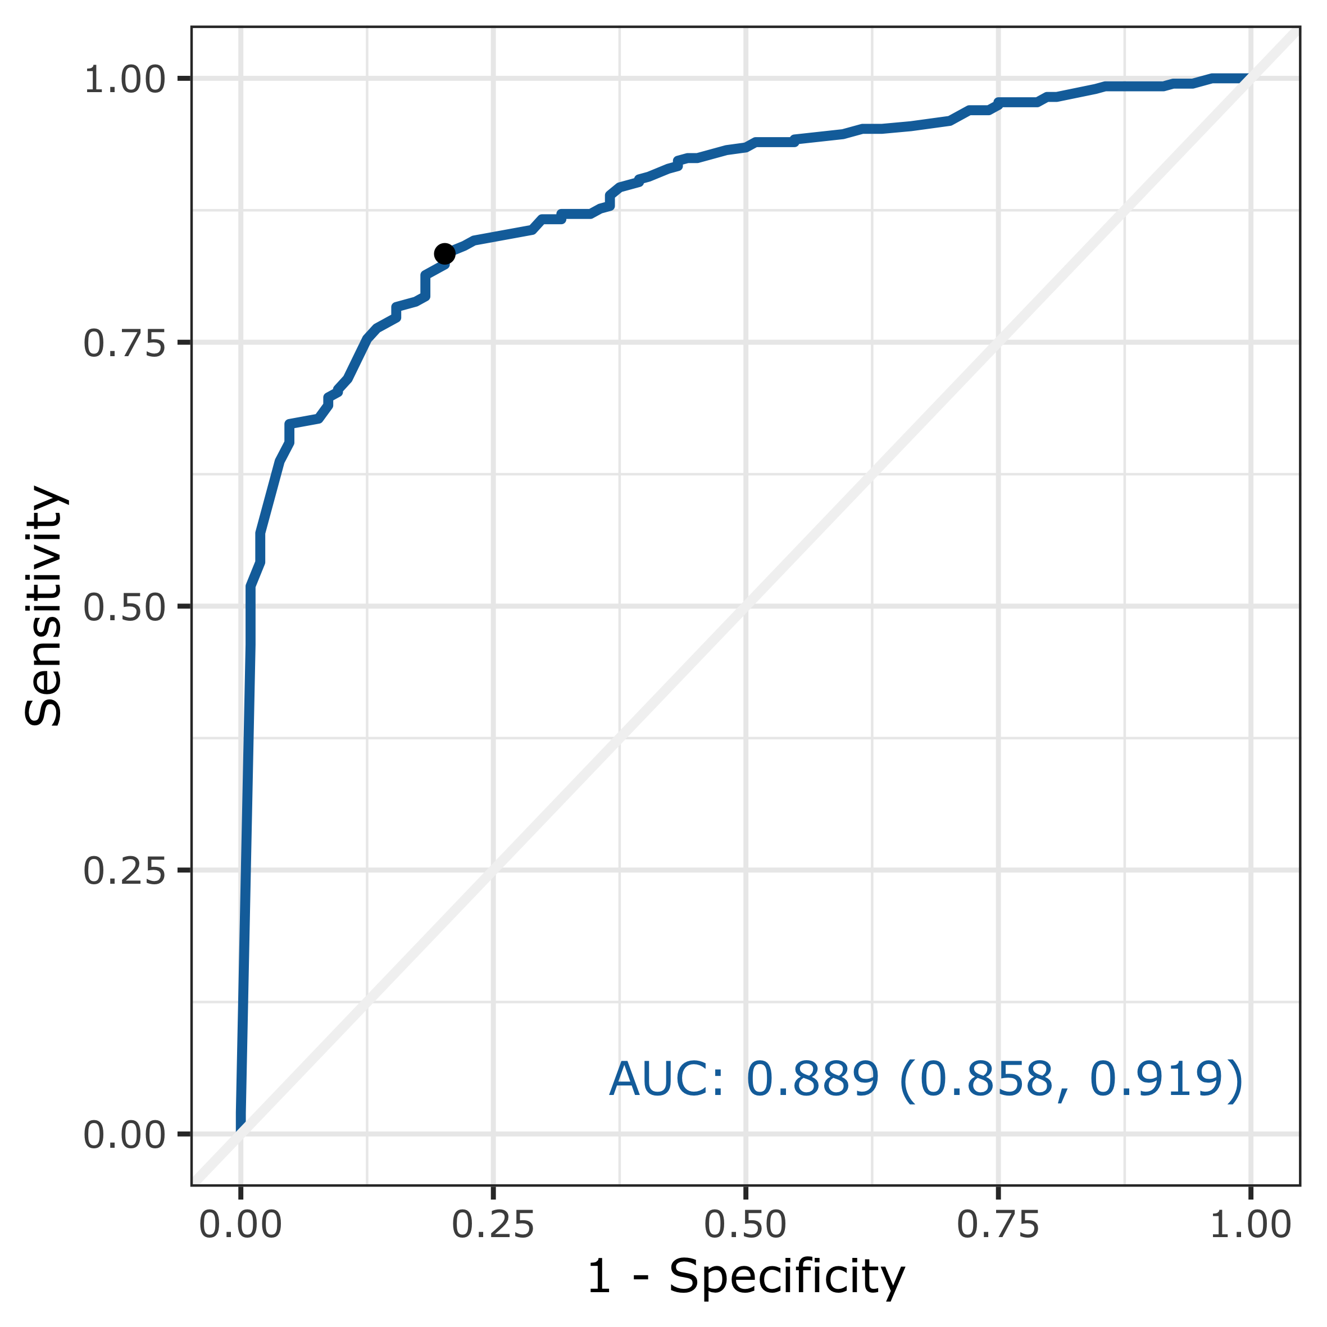
Trial 2: Any abnormality
AUC 0.889 of system B in detecting “any abnormality”, against Reader 1 (n =501).
At “•” point (the Youden index maximum)
 | Sensitivity | Specificity
System B | 82% | 80%
Notes:
Only system B included a reading for “any abnormality”.

Slide 39
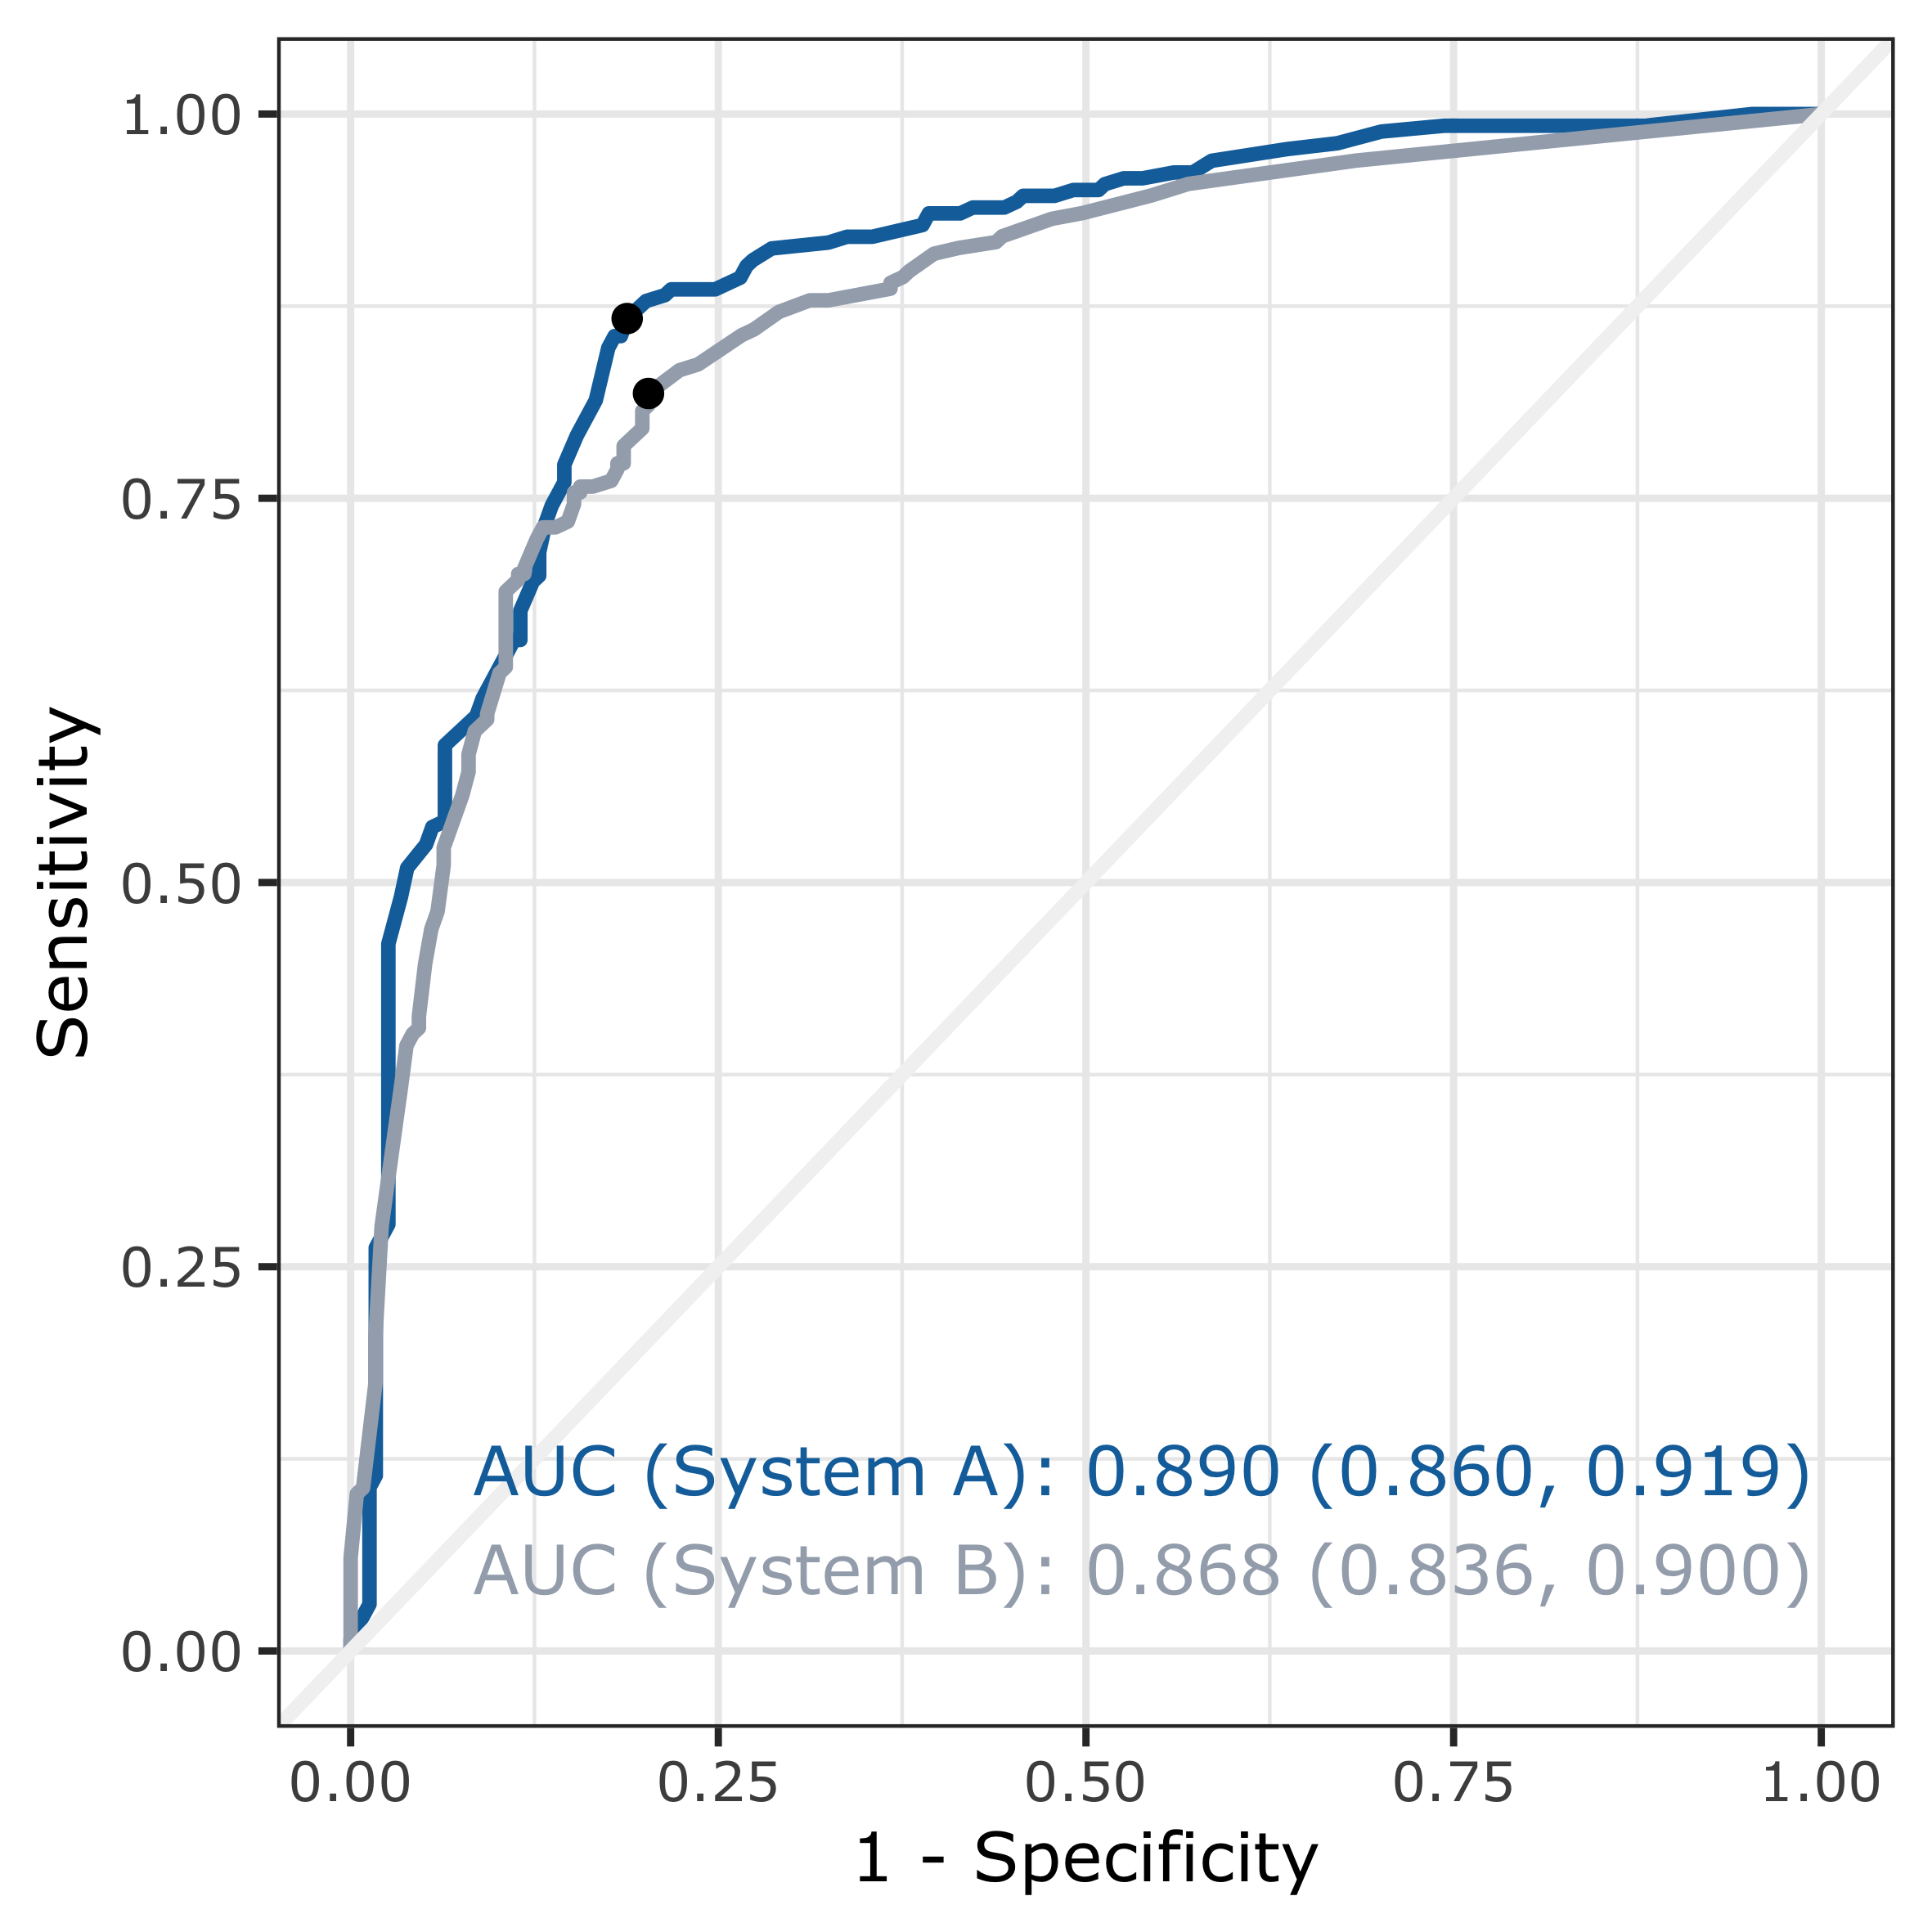
Trial 2: Tuberculosis
AUC 0.890 and 0.868 of systems A & B respectively in detecting tuberculosis, against Reader 2 (n =501).
At “•” point (the Youden index maximum)
 | Sensitivity | Specificity
System A | 87% | 81%
System B | 82% | 80%
Notes:
Both systems detected tuberculosis.

Slide 40
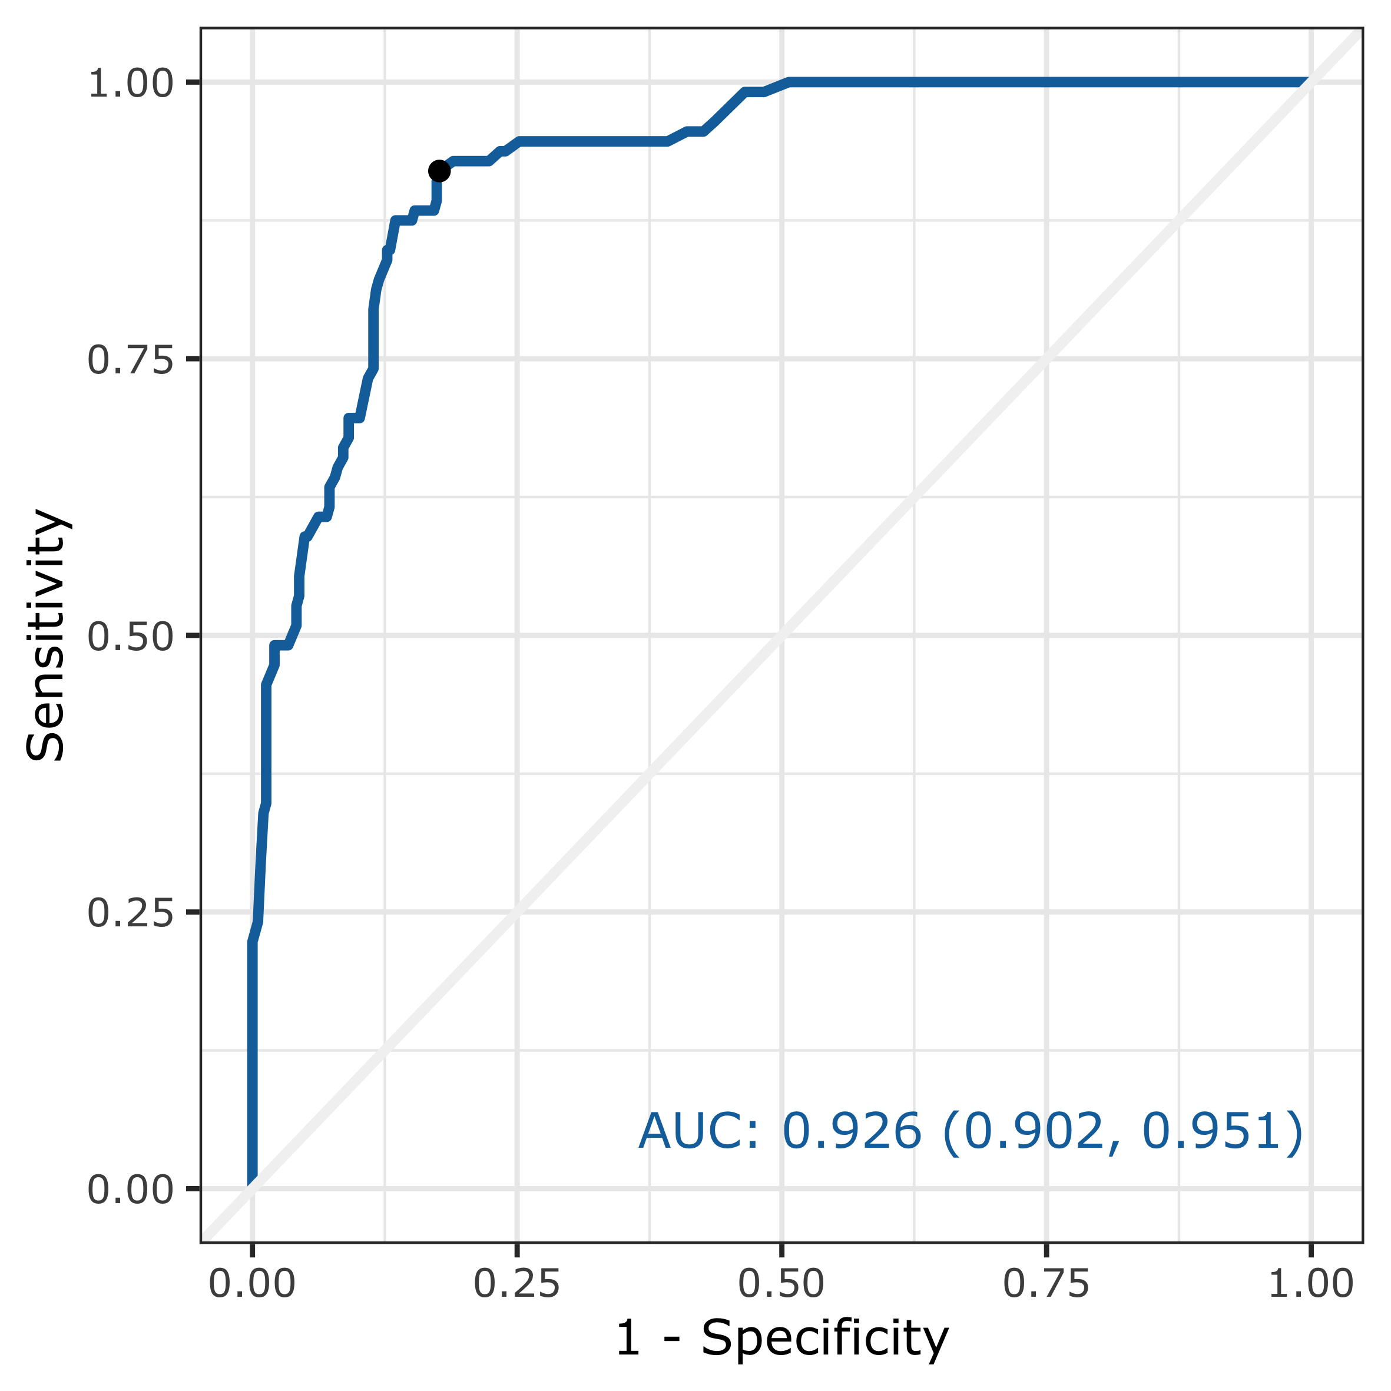
Trial 2: Silicosis
AUC 0.926 of system A in detecting silicosis ≥ 1/1 against reader 1 (n =501).
At “•” point (the Youden index maximum)
 | Sensitivity | Specificity
System A | 92% | 82%
Notes:
Only system A detected silicosis.

Slide 41
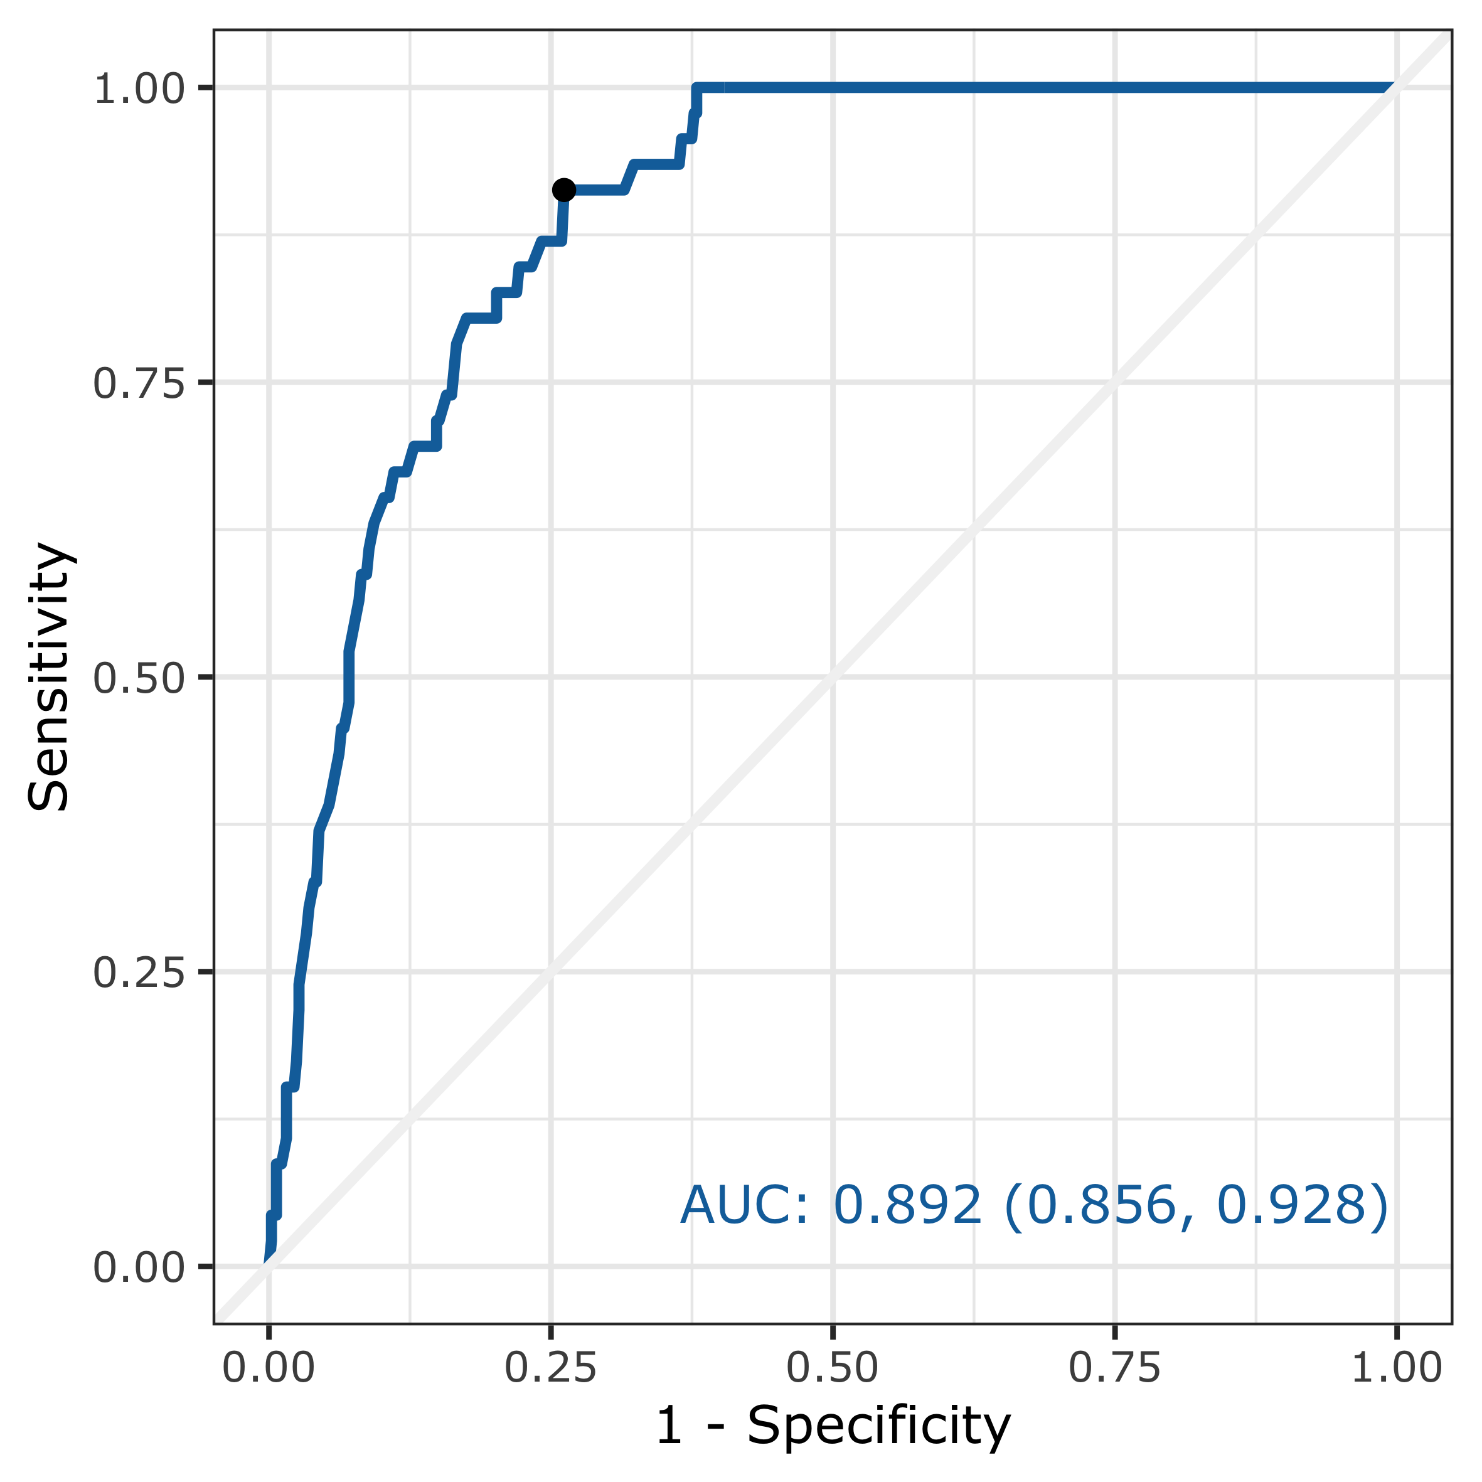
Trial 2: Silicotuberculosis
AUC 0.892 of system A in detecting silicoTB ≥ 1/1 against Reader 2 (n =501).
At “•” point (the Youden index maximum)
 | Sensitivity | Specificity
System A | 91% | 74%
Notes:
Only system A detected silicosis (and silicotuberculosis).

Slide 42
Next steps on this – (RODNEY or STEVE need to make this accurate
Tuberculosis System A with Reader 2 Sensitivity 86.7% Specificity 81.2% Balanced accuracy 84.0% | Lungs with TB N=263 | No TB N=234
CAD Positive N=272 | True positive 228 | False positive 44
CAD Negative N=225 | False negative 35 | True negative 190
287 CXRs – including ~100 ex-miners plus current miners who presented to the clinic at Harmony Gold May-June 2019
Assessed by 2 (or in some cases 3) AI companies
Those in which at all vendors agreed were normal or TB only sent to 2-person panel; others sent to radiologist + 4-person Panel
Results: ……
Notes:
Shouldn’t “diseased “ be replaced by TB? – we didn’t have 501 for TB?

Slide 43
Next steps on this – (RODNEY or STEVE need to make this accurate
Silicosis (≥1/1) System A with Reader 1 Sensitivity 92.0% Specificity 82.3% Balanced accuracy 87.2% | Diseased lungs N=112 | Non-diseased lungs N=385
CAD Positive N=171 | True positive 103 | False positive 68
CAD Negative N=326 | False negative 9 | True negative 317
287 CXRs – including ~100 ex-miners plus current miners who presented to the clinic at Harmony Gold May-June 2019
Assessed by 2 (or in some cases 3) AI companies
Those in which at all vendors agreed were normal or TB only sent to 2-person panel; others sent to radiologist + 4-person Panel
Results: ……
Notes:
Summarize for silicosis using the best of the systems (we didn’t have 501 for silicosis)

Slide 44
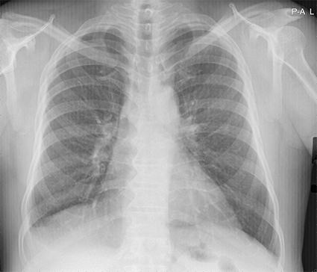
It’s silicosis
It’s normal
Total of 501 images | Reader 1 | Reader 2 | Consensus
Any abnormality | 397 abnormal | 418 abnormal | 434 / 501 (87%)
Tuberculosis | 213 had TB | 264 had TB | 414 / 501 (83%)
Silicosis ≥ 1/1 | 112 had silicosis | 80 had silicosis | 433 / 501 (86%)
Silicotuberculosis ≥ 1/1 | 72 had silicoTB | 47 had silicoTB | 436 / 501 (87%)

Slide 45
 | Reader 1 | Reader 2 | Consensus | Kappa Score | Kappa Agreement
Any abnormality | 397 | 418 | 87% | 0.561 | Moderate
Tuberculosis | 213 | 264 | 83% | 0.655 | Substantial
Silicosis ≥ 1/1 | 112 | 80 | 86% | 0.565 | Moderate
Silicotuberculosis ≥ 1/1 | 72 | 47 | 87% | 0.384 | Fair
Notes:
Not sure if we want to include kappa scores – but I added them here. They are a bit confusing. Kappa scores attempt to remove the odds of “random agreement”.

Slide 46
Trial #3 – New vendor validation: outline
An 867-image dataset selected by the MBOD through Harmony Gold, included TB (30%), silicosis (46%) and normal (24%) images.
Images were anonymized to remove any worker information or diagnosis
The vendor had 2½ hours to download and process the image set
CAD scores were analysed to determine if the vendor had similar or better performance compared with the other previously assessed vendors
CAD scores included: Abnormal, TB and Silicosis.

Slide 47
Trial #3 – New vendor validation: performance
TB detection failed to be significantly better than randomly flipping a coin
Silicosis detection was slightly better, but still can only be considered a “fair” performance, and would not provide much utility in a triage system at MBOD
(AUC needs to be near 0.900 or higher)

Slide 48
Trial #3 – New vendor validation: scanned images
Dataset included some lower quality scanned images
154 images, 18% of the total
Re-running the analysis excluding these images led to very similar results
Interesting that the system performance was roughly the same whether including or excluding scanned images, but the baseline performance was too low to draw a meaningful conclusion
Notes:
The dots need to be explained . STEVE
Explained in previous slide 16.

Slide 49
Next steps on this – (RODNEY or STEVE need to make this accurate
Tuberculosis Trial 3 vendor Sensitivity: 39% Specificity: 65% Balanced accuracy: 52% | Lungs with TB N=257 | Lungs without TB N=608
CAD Positive N=312 | True positive 100 | False positive 212
CAD Negative N=553 | False negative 157 | True negative 396
287 CXRs – including ~100 ex-miners plus current miners who presented to the clinic at Harmony Gold May-June 2019
Assessed by 2 (or in some cases 3) AI companies
Those in which at all vendors agreed were normal or TB only sent to 2-person panel; others sent to radiologist + 4-person Panel
Results: ……

Slide 50
Next steps on this – (RODNEY or STEVE need to make this accurate
Silicosis Trial 3 vendor Sensitivity: 66% Specificity: 71% Balanced accuracy: 69% | Lungs with silicosis N=401 | No silicosis N=464
CAD Positive N=402 | True positive 266 | False positive 136
CAD Negative N=463 | False negative 135 | True negative 328
287 CXRs – including ~100 ex-miners plus current miners who presented to the clinic at Harmony Gold May-June 2019
Assessed by 2 (or in some cases 3) AI companies
Those in which at all vendors agreed were normal or TB only sent to 2-person panel; others sent to radiologist + 4-person Panel
Results: ……

Slide 51
Next steps on this – (RODNEY or STEVE need to make this accurate
Any abnormality Trial 3 vendor Sensitivity: 46% Specificity: 80% Balanced accuracy: 63% | Abnormal lungs N=658 | No abnormality N=207
CAD Positive N=348 | True positive 305 | False positive 43
CAD Negative N=517 | False negative 353 | True negative 164
287 CXRs – including ~100 ex-miners plus current miners who presented to the clinic at Harmony Gold May-June 2019
Assessed by 2 (or in some cases 3) AI companies
Those in which at all vendors agreed were normal or TB only sent to 2-person panel; others sent to radiologist + 4-person Panel
Results: ……

Slide 52
Implications
For the last vendor (vendor e)
Of 401 miners who had silicosis, this system would have missed 135 of them - i.e.~30%!
Of 257 miners with TB, the system would have missed 157 – i.e. most (~60%) !
Of 658 miners with abnormal (silicosis, TB or both), the system would have missed … STEVE
(Unless strong human reader capacity to catch false negatives)
So:
Trial 1: CAD was very promising - (recall, Trial 1 had vendor a with sensitivity of 98.2% and a specificity of 98.2% for distinguishing abnormal from normal.
Trial 2: CAD systems could come close to expert readers in identifying TB and silicosis in this population, in the real-world specific use settings.
Trial 3: Vendor E’s system not ready
THUS: we still don’t have the right system readily available
Let’s discuss next steps after the rest of the presentations
…But these could include:… (next page)

Slide 53
Some potential options – or combination of options for next steps:
Work with Vendor E on improving performance, giving “right” answers on the 856; then re-test on the 501 CXRS with external readers as gold standard.
Return to Vendors A and B and see if a commercial model could be worked out; and if so, re-test to validate before confirming contract.
See if U Wits could develop an accurate system quickly (with or without CIHR grant) and, if works well, work out financial arrangement for going forward.
Ask whichever Vendor is most amenable to work with to set thresholds to maximize sensitivity (or specificity)
Provide more training for MBOD (human) readers: “catch” false + (or false neg.)
PLUS: Study whatever option(s) decided upon - monitor challenges and successes in implementation, including efficiency gain, cost-efficiency, cost-benefit, and possible ultimately impact on ex-miners and their families.

Slide 54
Questions so far? (Steve to speak to statistical issues; Rodney to issues around the field study and CXR readings)

Slide 55
Next part of presentation
Prof Rodney Ehrlich: Epidemiology and issues of access for migrant ex-miners
Steve Barker: Testing algorithms (using age, years of service, and latecy to improve efficiency in triage)
(Andre: the impressive database and what it is telling us)
Prof Jerry Spiegel: Pros and cons of implementing AI-based system – and how an implementation study could be done…. And possible next steps

Slide 56
All feedback – questions
… and especially:
suggestions for improvements
& further research questions
would be much appreciated.
Other researchers most welcome!

